Slide 1
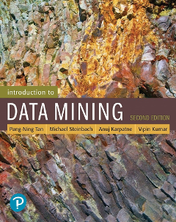
Chapter Four: Support Vector Machines & Imbalanced Classes
CSCE 5380/4380 – Data Mining

Slide 2
Outline
Support Vector Machines
Nonlinear Support Vector Machines
Characteristics of SVM
Class Imbalance Problem
Measures of Classification Performance & Imbalanced Classes
ROC (Receiver Operating Characteristic)
Building Classifiers with Imbalanced Training Set
Introduction to Data Mining, 2nd Edition

Slide 3
Support Vector Machines
Find a linear hyperplane (decision boundary) that will separate the data

Slide 4
Support Vector Machines
One Possible Solution

Slide 5
Support Vector Machines
Another possible solution

Slide 6
Support Vector Machines
Other possible solutions

Slide 7
Support Vector Machines
Which one is better? B1 or B2?
How do you define better?

Slide 8
Support Vector Machines
Find hyperplane maximizes the margin => B1 is better than B2

Slide 9
Support Vector Machines

Slide 10
Linear SVM
Linear model:
Learning the model is equivalent to determining the values of
How to find from training data?

Slide 11

Learning Linear SVM
Objective is to maximize:
Which is equivalent to minimizing:
Subject to the following constraints:
or
This is a constrained optimization problem
Solve it using Lagrange multiplier method
$$y_{i}(w•x_{i}+b)≥1, i=1,2,...,N$$

Slide 12
Example of Linear SVM
Support vectors

Slide 13
Learning Linear SVM
Decision boundary depends only on support vectors
If you have data set with same support vectors, decision boundary will not change
How to classify using SVM once w and b are found? Given a test record, x_{i}

Slide 14
Support Vector Machines
What if the problem is not linearly separable?

Slide 15
Support Vector Machines
What if the problem is not linearly separable?
Introduce slack variables
Need to minimize:
Subject to:
If k is 1 or 2, this leads to similar objective function as linear SVM but with different constraints (see textbook)

Slide 16
Support Vector Machines
Find the hyperplane that optimizes both factors

Slide 17
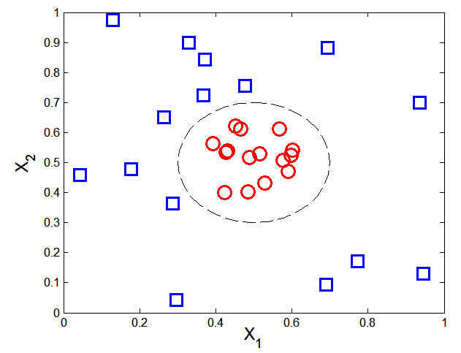

Nonlinear Support Vector Machines
What if decision boundary is not linear?

Slide 18
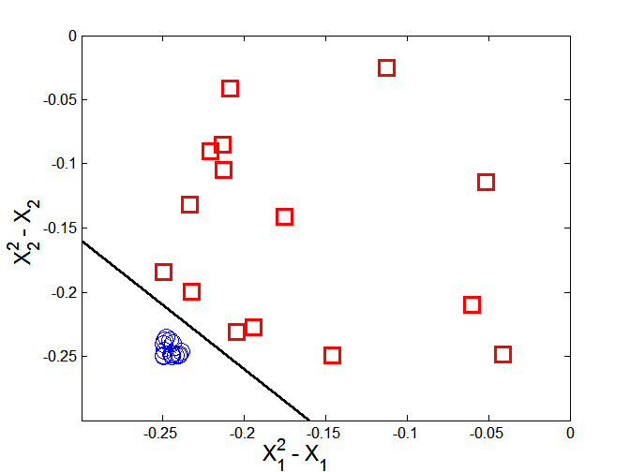



Nonlinear Support Vector Machines
Transform data into higher dimensional space
Decision boundary:

Slide 19
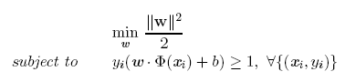

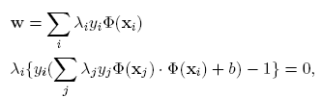

Learning Nonlinear SVM
Optimization problem:
Which leads to the same set of equations (but involve Φ(x) instead of x)

Slide 20
Learning NonLinear SVM
Issues:
What type of mapping function Φ should be used?
How to do the computation in high dimensional space?
Most computations involve dot product Φ(x_{i})• Φ(x_{j})
Curse of dimensionality?

Slide 21

Learning Nonlinear SVM
Kernel Trick:
Φ(x_{i})• Φ(x_{j}) = K(x_{i}, x_{j})
K(x_{i}, x_{j}) is a kernel function (expressed in terms of the coordinates in the original space)
Examples:

Slide 22
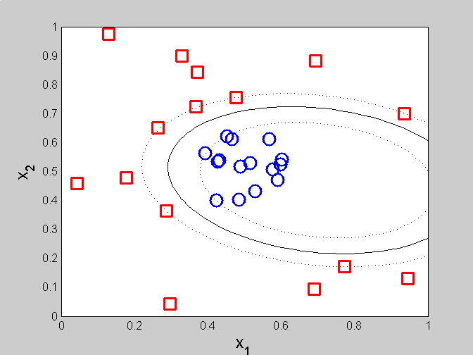
Example of Nonlinear SVM
SVM with polynomial degree 2 kernel

Slide 23
Learning Nonlinear SVM
Advantages of using kernel:
Don’t have to know the mapping function Φ
Computing dot product Φ(x_{i})• Φ(x_{j}) in the original space avoids curse of dimensionality
Not all functions can be kernels
Must make sure there is a corresponding Φ in some high-dimensional space
Mercer’s theorem (see textbook)

Slide 24
Characteristics of SVM
The learning problem is formulated as a convex optimization problem
Efficient algorithms are available to find the global minima
Many of the other methods use greedy approaches and find locally optimal solutions
High computational complexity for building the model
Robust to noise
Overfitting is handled by maximizing the margin of the decision boundary,
SVM can handle irrelevant and redundant attributes better than many other techniques
The user needs to provide the type of kernel function and cost function
Difficult to handle missing values
What about categorical variables?

Slide 25
Class Imbalance Problem
Lots of classification problems where the classes are skewed (more records from one class than another)
Credit card fraud
Intrusion detection
Defective products in manufacturing assembly line
COVID-19 test results on a random sample
Key Challenge:
Evaluation measures such as accuracy are not well-suited for imbalanced class

Slide 26
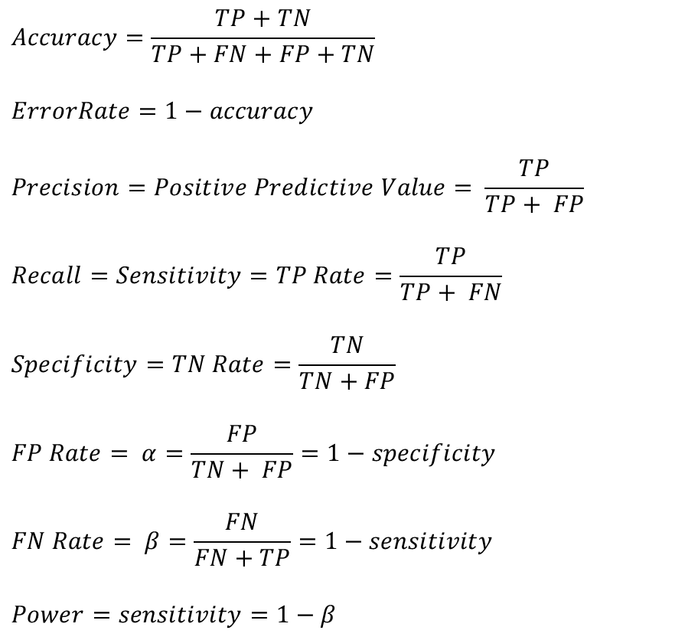
Measures of Classification Performance
 | PREDICTED CLASS
ACTUAL CLASS |  | Yes | No
 | Yes | TP | FN
 | No | FP | TN
α is the probability that we reject the null hypothesis when it is true. This is a Type I error or a false positive (FP).
β is the probability that we accept the null hypothesis when it is false. This is a Type II error or a false negative (FN).

Slide 27
Problem with Accuracy
Consider a 2-class problem
Number of Class NO examples = 990
Number of Class YES examples = 10
If a model predicts everything to be class NO, accuracy is 990/1000 = 99 %
This is misleading because this trivial model does not detect any class YES example
Detecting the rare class is usually more interesting (e.g., frauds, intrusions, defects, etc)
 | PREDICTED CLASS
ACTUAL CLASS |  | Class=Yes | Class=No
 | Class=Yes | 0 | 10
 | Class=No | 0 | 990

Slide 28
Which model is better?
 | PREDICTED
ACTUAL |  | Class=Yes | Class=No
 | Class=Yes | 0 | 10
 | Class=No | 0 | 990
A
Accuracy: 99%
 | PREDICTED
ACTUAL |  | Class=Yes | Class=No
 | Class=Yes | 10 | 0
 | Class=No | 500 | 490
B
Accuracy: 50%

Slide 29
Alternative Measures
 | PREDICTED CLASS
ACTUAL CLASS |  | Class=Yes | Class=No
 | Class=Yes | a | b
 | Class=No | c | d

Slide 30
Alternative Measures
 | PREDICTED CLASS
ACTUAL CLASS |  | Class=Yes | Class=No
 | Class=Yes | 10 | 0
 | Class=No | 10 | 980
 | PREDICTED CLASS
ACTUAL CLASS |  | Class=Yes | Class=No
 | Class=Yes | 1 | 9
 | Class=No | 0 | 990

Slide 31
Which of these classifiers is better?
 | PREDICTED CLASS
ACTUAL CLASS |  | Class=Yes | Class=No
 | Class=Yes | 40 | 10
 | Class=No | 10 | 40
A
B
 | PREDICTED CLASS
ACTUAL CLASS |  | Class=Yes | Class=No
 | Class=Yes | 40 | 10
 | Class=No | 1000 | 4000

Slide 32
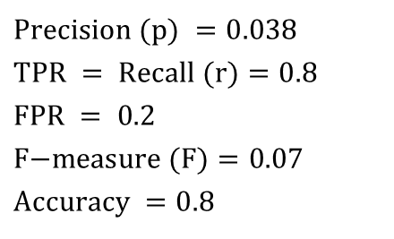
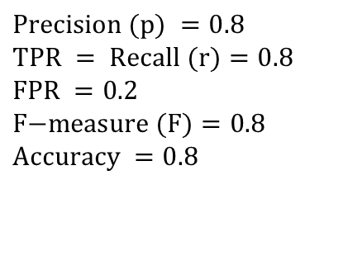


Alternative Measures
A | PREDICTED CLASS
ACTUAL CLASS |  | Class=Yes | Class=No
 | Class=Yes | 40 | 10
 | Class=No | 10 | 40
$$\text{Precision} (p) =0.8 \\ \text{TPR} = \text{Recall} (r)=0.8 \\ \text{FPR} =0.2 \\ \text{F}\text{−}\text{measure} (F)=0.8 \\ \text{Accuracy} =0.8$$
$$\frac{TPR}{FPR}=4$$
B | PREDICTED CLASS
ACTUAL CLASS |  | Class=Yes | Class=No
 | Class=Yes | 40 | 10
 | Class=No | 1000 | 4000
$$\text{Precision} (p) =0.038 \\ \text{TPR} = \text{Recall} (r)=0.8 \\ \text{FPR} =\text{ 0.2} \\ \text{F}\text{−}\text{measure} (F)=0.07 \\ \text{Accuracy} =0.8$$
$$\frac{TPR}{FPR}=4$$

Slide 33
ROC (Receiver Operating Characteristic)
A graphical approach for displaying trade-off between detection rate and false alarm rate
Developed in 1950s for signal detection theory to analyze noisy signals
ROC curve plots TPR against FPR
Performance of a model represented as a point in an ROC curve

Slide 34
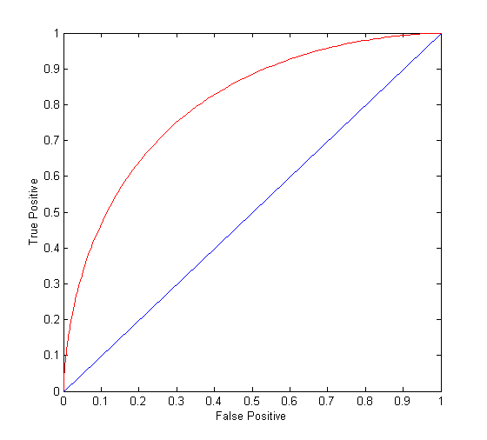
ROC Curve
(TPR,FPR):
(0,0): declare everything to be negative class
(1,1): declare everything to be positive class
(1,0): ideal
Diagonal line:
Random guessing
Below diagonal line:
prediction is opposite of the true class

Slide 35
ROC (Receiver Operating Characteristic)
To draw ROC curve, classifier must produce continuous-valued output
Outputs are used to rank test records, from the most likely positive class record to the least likely positive class record
By using different thresholds on this value, we can create different variations of the classifier with TPR/FPR tradeoffs
Many classifiers produce only discrete outputs (i.e., predicted class)
How to get continuous-valued outputs?
Decision trees, rule-based classifiers, neural networks, Bayesian classifiers, k-nearest neighbors, SVM

Slide 36
Example: Decision Trees
Decision Tree
Continuous-valued outputs

Slide 37
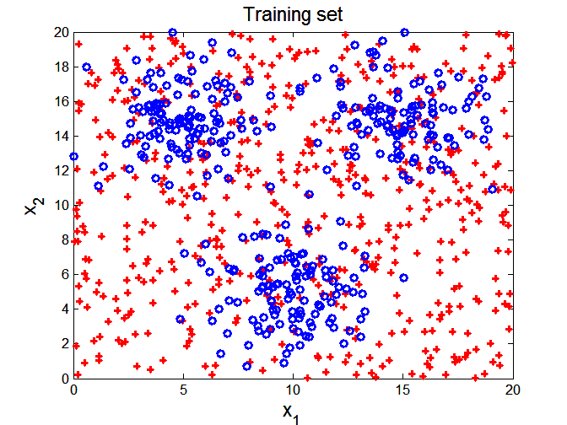

ROC Curve Example

Slide 38
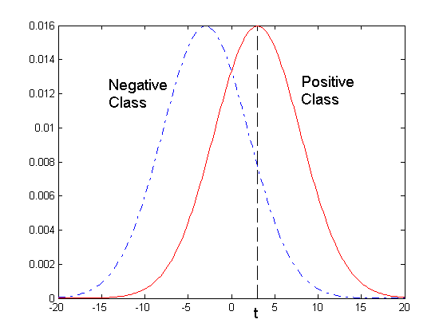
ROC Curve Example
- 1-dimensional data set containing 2 classes (positive and negative)
- Any points located at x > t is classified as positive
At threshold t:
TPR=0.5, FNR=0.5, FPR=0.12, TNR=0.88

Slide 39
How to Construct an ROC curve
Use a classifier that produces a continuous-valued score for each instance
The more likely it is for the instance to be in the + class, the higher the score
Sort the instances in decreasing order according to the score
Apply a threshold at each unique value of the score
Count the number of TP, FP, TN, FN at each threshold
TPR = TP/(TP+FN)
FPR = FP/(FP + TN)
Instance | Score | True Class
1 | 0.95 | +
2 | 0.93 | +
3 | 0.87 | -
4 | 0.85 | -
5 | 0.85 | -
6 | 0.85 | +
7 | 0.76 | -
8 | 0.53 | +
9 | 0.43 | -
10 | 0.25 | +

Slide 40
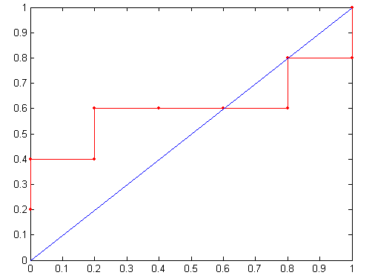
How to construct an ROC curve
Threshold >=
ROC Curve:

Slide 41
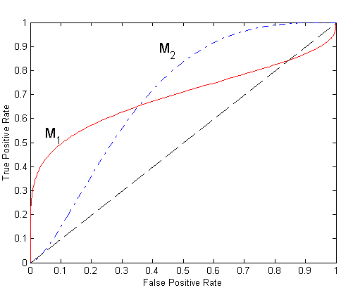
Using ROC for Model Comparison
No model consistently outperforms the other
M₁ is better for small FPR
M₂ is better for large FPR
Area Under the ROC curve (AUC)
Ideal:
Area = 1
Random guess:
Area = 0.5

Slide 42
Dealing with Imbalanced Classes - Summary
Many measures exists, but none of them may be ideal in all situations
Random classifiers can have high value for many of these measures
TPR/FPR provides important information but may not be sufficient by itself in many practical scenarios
Given two classifiers, sometimes you can tell that one of them is strictly better than the other
C1 is strictly better than C2 if C1 has strictly better TPR and FPR relative to C2 (or same TPR and better FPR, and vice versa)
Even if C1 is strictly better than C2, C1’s F-value can be worse than C2’s if they are evaluated on data sets with different imbalances
Classifier C1 can be better or worse than C2 depending on the scenario at hand (class imbalance, importance of TP vs FP, cost/time tradeoffs)

Slide 43
Which Classifier is better? Low Skew case
T1 | PREDICTED CLASS
ACTUAL CLASS |  | Class=Yes | Class=No
 | Class=Yes | 50 | 50
 | Class=No | 1 | 99
T2 | PREDICTED CLASS
ACTUAL CLASS |  | Class=Yes | Class=No
 | Class=Yes | 99 | 1
 | Class=No | 10 | 90
T3 | PREDICTED CLASS
ACTUAL CLASS |  | Class=Yes | Class=No
 | Class=Yes | 99 | 1
 | Class=No | 1 | 99

Slide 44
Which Classifier is better? Medium Skew case
T1 | PREDICTED CLASS
ACTUAL CLASS |  | Class=Yes | Class=No
 | Class=Yes | 50 | 50
 | Class=No | 10 | 990
T2 | PREDICTED CLASS
ACTUAL CLASS |  | Class=Yes | Class=No
 | Class=Yes | 99 | 1
 | Class=No | 100 | 900
T3 | PREDICTED CLASS
ACTUAL CLASS |  | Class=Yes | Class=No
 | Class=Yes | 99 | 1
 | Class=No | 10 | 990

Slide 45
Which Classifier is better? High Skew case
T1 | PREDICTED CLASS
ACTUAL CLASS |  | Class=Yes | Class=No
 | Class=Yes | 50 | 50
 | Class=No | 100 | 9900
T2 | PREDICTED CLASS
ACTUAL CLASS |  | Class=Yes | Class=No
 | Class=Yes | 99 | 1
 | Class=No | 1000 | 9000
T3 | PREDICTED CLASS
ACTUAL CLASS |  | Class=Yes | Class=No
 | Class=Yes | 99 | 1
 | Class=No | 100 | 9900

Slide 46
Building Classifiers with Imbalanced Training Set
Modify the distribution of training data so that rare class is well-represented in training set
Undersample the majority class
Oversample the rare class

